Slide 1
Homework #2 for Tuesday 12
Your assignment is to draft the specification for the ‘Orders’ table of our datawarehouse.
This specification should display the columns of the target table, the data source(s) and the source/target mapping (as we did this morning for the facts table),
Here are your sources of information:
Our corrected Data dictionary on next slide
Our corrected Snowflake schema for the Datawarehouse on slide #3
The source database (ODS) on slide #4
The specification for the facts table (the one we did on whiteboard this morning) is displayed on slide #5, as an example
You can work on PowerPoint or on paper.
You still work in groups of 3 or 4. You can switch partners if you like.
Send me your work by email, or bring it on paper tomorrow morning, with the names of all group members on it.

Slide 2
Data Dictionary
Product Dimension
Product Family
Product Line
Product
Diet Flag
Basic Measures
Sales
Parcels Count
Orders Count
Customers Count
Delivery Slot Dimension
Delivery Slot
Customer Dimension
Derived Measures
Fidelity
Household
Sector
Name
Address
Door Code
% diet = Diet Sales / Sales
Avg amount per order = Sales / Orders Count
Avg parcels per order = Parcels Count / Orders Count
Sales Growth = Sales this year / Sales last year - 1
Time Dimension
Year
Quarter
Month
Order Date
Delivery Date
Weekday
Order Dimension
Order #

Slide 3
Product Families
Diet Flag
Customers
Product Lines
Diet Flag
Fidelities
Products
Sectors
Facts Table
Sales
DWh
Households
Orders
Parcels
Delivery Slots
(Order) Time
Order Date
Months
Quarters
Years
Weekdays
Order Date

Slide 4
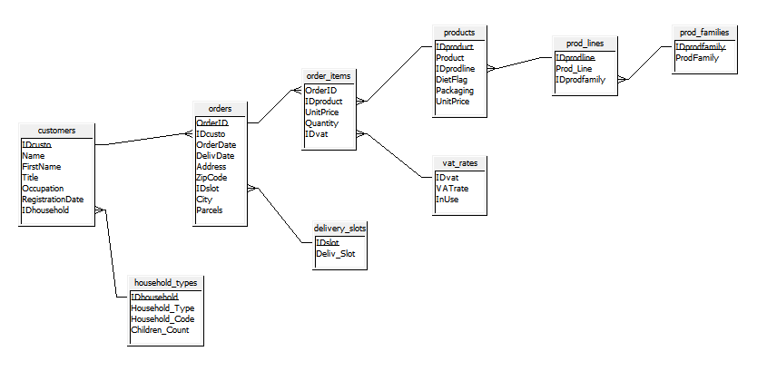
Source database (ODS)

Slide 5
Specification for the ‘dwh_facts’ table
order_items
OrderID
IDproduct
UnitPrice
Quantity
IDvat
dwh_facts
ID order
ID product
Sales
UnitPrice * Quantity
Primary key is displayed in bold.

